Slide 1

Reporting and Analyzing Equity
11
Chapter
UAA – ACCT 201 Principles of Financial Accounting Dr. Fred Barbee

Slide 2

IS FUN!
Chapter 11
Day One
ACCT 201

Slide 3
Chapter 11 - Day 1 - Agenda
Topic | LO | Read | HW
Corporate Form of Organization | C1, C2 | 466-571 | QS1, E1
Common Stock | P1 | 471-474 | E2, E3
Preferred Stock | C3, P2 | 474-478 | E4, E5, E6
Dividends | P3, P4 | 478-483 | E7, E8
No Homework Due Today!

Slide 4
What is a Corporation?
An artificial being, invisible, intangible, and existing only in contemplation of the law.

Slide 5
Advantages and Disadvantages of Corporations
11
Chapter

Slide 6

Advantages of Corporations
Separate Legal Entity
Limited Liability of Stockholders
Ownership Rights Are Transferable
Continuous Life

Slide 7
Advantages of Corporations
Stockholders Are Not Corporate Agents
Ease of Capital Accumulation

Slide 8
Disadvantages of Corporations
Governmental Regulation
Corporate Taxes
Limited Liability
Separation of Ownership and Control

Slide 9
Organizing and Managing a Corporation
11
Chapter

Slide 10
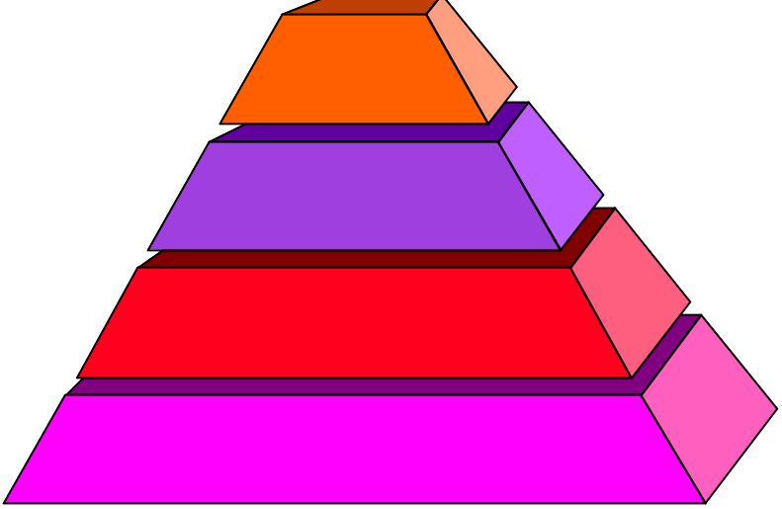
Organizing and Managing a Corporation
Exh.
11.1
Stockholders
Board of Directors
President, Vice-President, and Other Officers
Employees of the Corporation

Slide 11
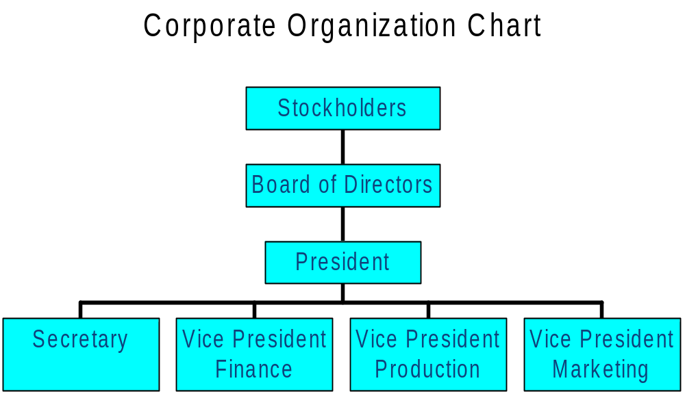
Organizing and Managing a Corporation
Stockholders usually meet once a year
Ultimate control
Selected by a vote of the stockholders
Overall responsibility for managing the company

Slide 12
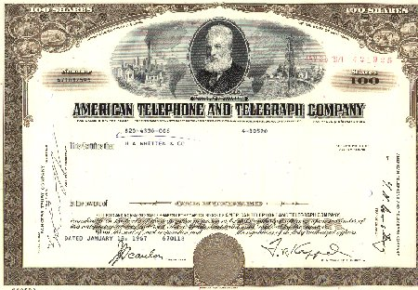
Stock Certificates and Transfer
Each unit of ownership is called a share of stock.
A stock certificate serves as proof that a stockholder has purchased shares.

Slide 13
Rights of Stockholders
11
Chapter

Slide 14
Rights of Common Stockholders
Vote at stockholders’ meetings.
Sell stock.
Purchase additional shares of stock.

Slide 15
Rights of Common Stockholders
Share equally with other common
stockholders in any dividends.
Share equally in any assets remaining after creditors are paid in a liquidation of corporate assets.

Slide 16
Basics of Capital Stock
11
Chapter

Slide 17
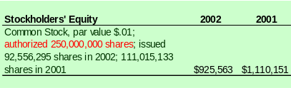
Basics of Capital Stock
Total amount of stock that a corporation’s charter authorizes it to sell.
ACCT 201 ACCT 201 ACCT 201

Slide 18
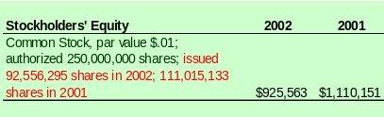
Basics of Capital Stock
Total amount of stock that has been issued to stockholders.
ACCT 201 ACCT 201 ACCT 201

Slide 19
Basics of Capital Stock
Par value is an arbitrary amount assigned to each share of stock when it is authorized.
Market price is the amount that each share of stock will sell for in the market.
ACCT 201 ACCT 201 ACCT 201

Slide 20
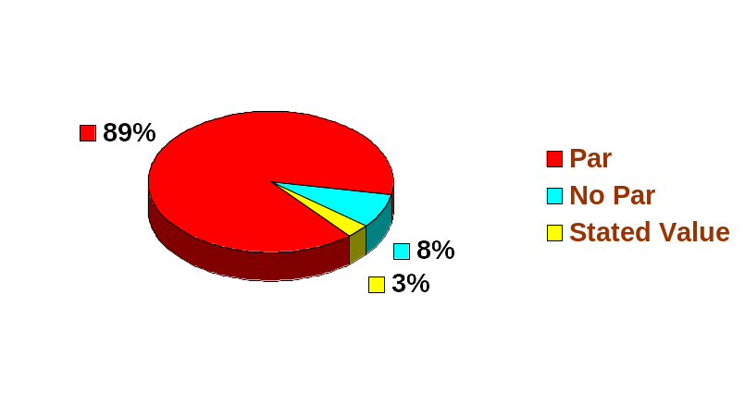
Classes of Stock
Par, No Par, and Stated
Value Common Stock
ACCT 201 ACCT 201 ACCT 201

Slide 21
Issuing Par Value Stock
Record # of shares issued x the par value per share in Common Stock: 100,000 x $2 = $200,000
Record cash received: 100,000 x $25 = $2,500,000
On September 1, 2002, Matrix, Inc. issued 100,000 shares of $2 par value stock for $25 per share.
Record remainder in Contributed Capital in excess of Par Value: $2,500,000 - $200,000 = $2,300,000.
ACCT 201 ACCT 201 ACCT 201

Slide 22

Stockholders’ Equity
Corporate Equity Accounts
Common
Stock
Retained
Earnings
Revenues
Expenses
Dividends

Slide 23
Stockholders’ Equity
Assets
Liabilities
Owners’
Equity
=
+
Capital
Stock
Retained
Earnings
The Accounting Equation
A = L + OE
Revenue
Expenses
-
=
Net
Income

Slide 24
Stockholders’ Equity
=
Assets
DR
CR
Liabilities
+
+
-
Owners’ Equity
DR
CR
-
+
DR
CR
-
+

Slide 25
Issuing Par Value Stock
11
Chapter

Slide 26
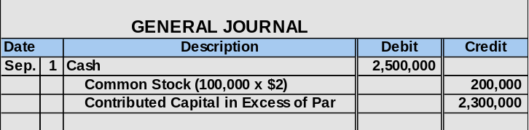
Issuing Par Value Stock
ACCT 201 ACCT 201 ACCT 201

Slide 27
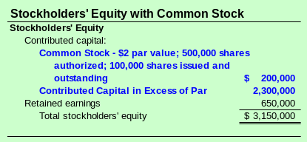
Issuing Par Value Stock
ACCT 201 ACCT 201 ACCT 201

Slide 28
Preferred Stock
11
Chapter

Slide 29
Preferred Stock
A separate class of stock, typically having priority over common shares in . . .
  Dividend distributions.
  Distribution of assets in case of liquidation.
Usually has a stated dividend rate.
Normally has no voting rights.
ACCT 201 ACCT 201 ACCT 201

Slide 30
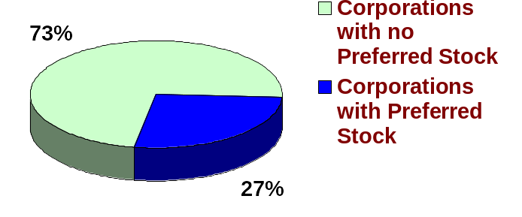
Preferred Stock
ACCT 201 ACCT 201 ACCT 201

Slide 31
Cumulative Vs. Noncumulative
Dividends in arrears must be paid before dividends may be paid on common stock.
Cumulative
Undeclared dividends from current and prior years do not have to be paid in future years.
Noncumulative
Most preferred stock is cumulative.
ACCT 201 ACCT 201 ACCT 201

Slide 32
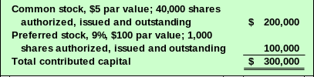
Cumulative Vs. Noncumulative
Example: Consider the following partial Statement of Stockholders’ Equity
The Board of Directors did not declare or pay dividends in 2001. In 2002, the Board declares and pays cash dividends of $42,000.
ACCT 201 ACCT 201 ACCT 201

Slide 33
Cumulative Vs. Noncumulative
Preferred
Common
If Preferred Stock is
Noncumulative
:
Year 2001
No dividend paid
$ -0-
$ -0-
Year 2002
Step 1: Current preferred dividend
$
9,000
Step 2: Remainder to common shareholders
$
33,000
If Preferred Stock is
Cumulative
:
Year 2001
No dividend paid
$ -0-
$ -0-
Year 2002
Step 1: Dividends in arrears
$
9,000
Step 2: Current preferred dividend
9,000
Step 3: Remainder to common shareholders
$
24,000
Totals
$
18,000
$
24,000
ACCT 201 ACCT 201 ACCT 201

Slide 34
Participating Vs. Nonparticipating
Dividends may exceed a stated amount once common stockholders receive a dividend equal to the preferred stated rate.
Participating
Dividends are limited to a maximum amount each year – usually the stated dividend rate.
Nonparticipating
Most preferred stock is nonparticipating.
ACCT 201 ACCT 201 ACCT 201

Slide 35
Cash Dividends
11
Chapter

Slide 36




Cash Dividends
Regular cash dividends provide a return to investors and almost always affect the stock’s market value.
June
30
Stockholders
Corporation
Dividends
ACCT 201 ACCT 201 ACCT 201

Slide 37
Cash Dividends
To pay a cash dividend, the corporation must have a sufficient balance in retained earnings and the cash necessary to pay the dividend.

Slide 38
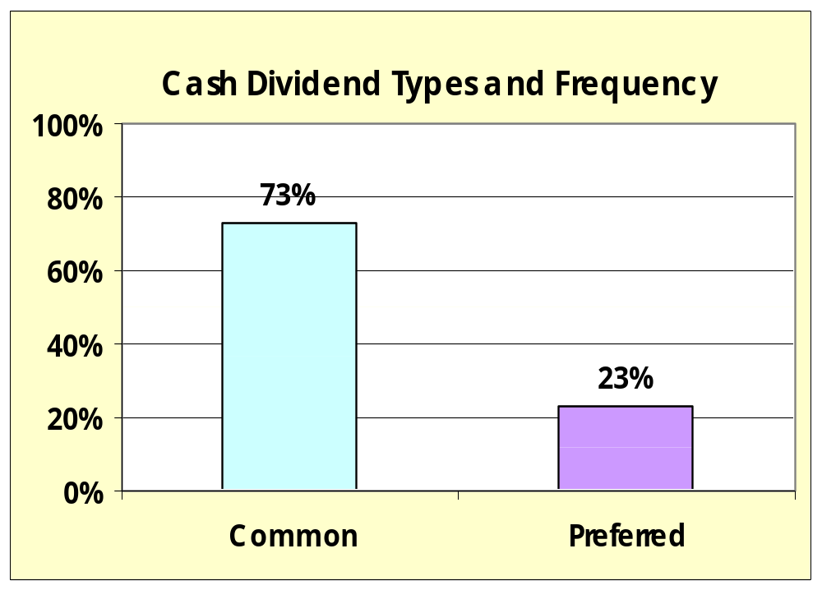
Cash Dividends

Slide 39



Cash Dividends
Three important dates
Dividends
Date of Declaration
Date of Record
Date of Payment
Record liability
for dividend.
No entry
required.
Record payment of
cash to stockholders.
ACCT 201 ACCT 201 ACCT 201

Slide 40
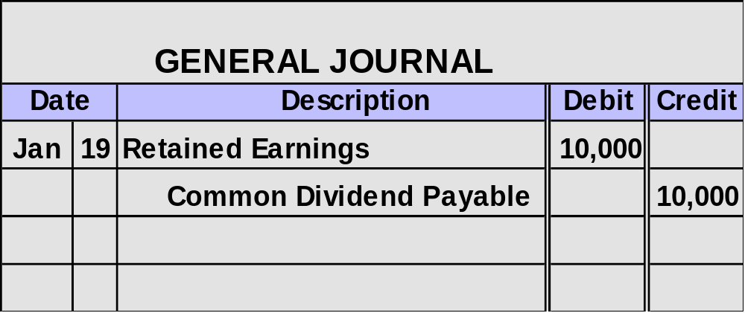
Entries For Cash Dividends
On January 19, a $1 per share cash dividend is declared on Dana, Inc.’s 10,000 common shares outstanding.
Dividends
Date of Declaration
Record liability
for dividend.
ACCT 201 ACCT 201 ACCT 201

Slide 41
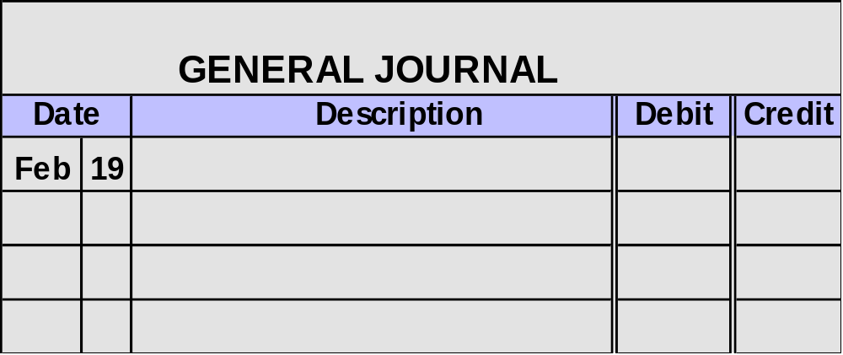
Entries for Cash Dividends
On January 19, a $1 per share cash dividend is declared on Dana, Inc.’s 10,000 common shares outstanding. The date of record is February 19.
Date of Record
No entry
required.
No Entry Required

Slide 42
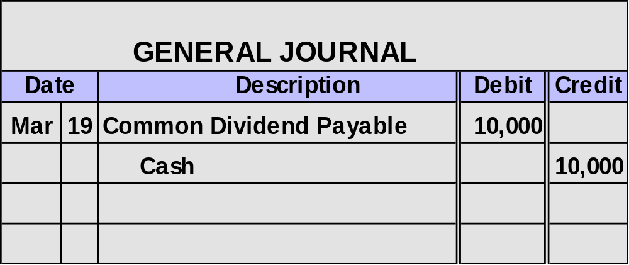
Entries For Cash Dividends
On 01/19, a $1 per share cash dividend is declared on Dana, Inc.’s 10,000 common shares outstanding. The date of record is 02/19. The dividend is paid on 03/19.
Date of Payment
Record payment of
cash to stockholders.
ACCT 201 ACCT 201 ACCT 201

Slide 43
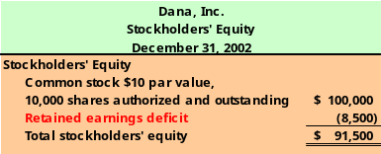
Deficits & Cash Dividends
Created when a company incurs cumulative losses or pays dividends greater than total profits earned in other years.
ACCT 201 ACCT 201 ACCT 201

Slide 44
Stock Dividends
11
Chapter

Slide 45


Stock Dividends
The corporation distributes additional shares of its own stock to its stockholders without receiving any payment in return.
100 Shares
HotAir, Inc.
Common Stock
$1 par value

Slide 46
Why Stock Dividends
Can be used to keep the market price of the stock affordable.
Can provide evidence of management’s confidence that the company is doing well.
100 Shares
HotAir, Inc.
Common Stock
$1 par value

Slide 47
Entries for Stock Dividends
Small Stock Dividend
Distribution is ≤ 25% of the previously outstanding shares.
Capitalize retained earnings for the market value of the shares to be distributed.
Large Stock Dividend
Distribution is > 25% of the previously outstanding shares.
Capitalize retained earnings for the minimum amount required by state law, usually par or stated value of the shares.
ACCT 201 ACCT 201 ACCT 201

Slide 48
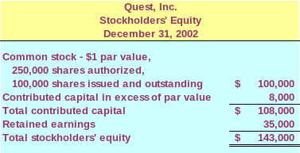
Entries for Stock Dividends
Here is the stockholders’ equity section of Quest’s balance sheet prior to the declaration of a stock dividend.
ACCT 201 ACCT 201 ACCT 201

Slide 49
Recording a Small Stock Dividend
On December 31, 2002, Quest declared a 2% stock dividend, when the stock was selling for $10 per share.
The stock will be distributed to stockholders on January 20, 2003. Let’s make the December 31 entry.

Slide 50
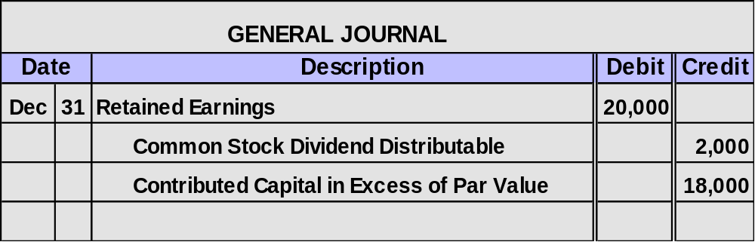
Recording Stock Dividends
Prepare the Journal Entry
100,000 × 2% = 2,000 × $10 = $20,000
2,000 × $1 par = $2,000
ACCT 201 ACCT 201 ACCT 201

Slide 51
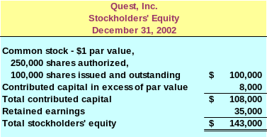
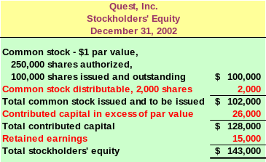
Before the
stock
dividend.
After the
stock
dividend.

Slide 52
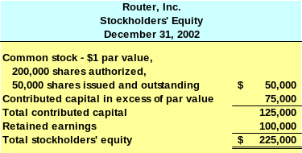
Large Stock Dividends
Router, Inc. shows the following stockholders’ equity section just prior to issuing a large stock dividend.

Slide 53
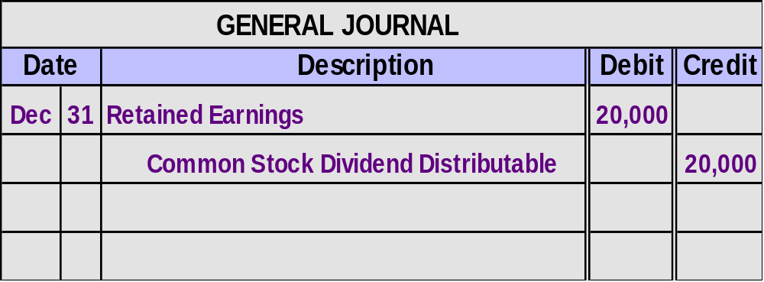
Large Stock Dividends
On December 31, 2002, Router declared a 40% stock dividend, when the stock was selling for $8 per share. State law requires that large stock dividends be capitalized at par value per share.
50,000 × 40% = 20,000 shares × $1 par value = $20,000

Slide 54
Stock Splits
11
Chapter

Slide 55
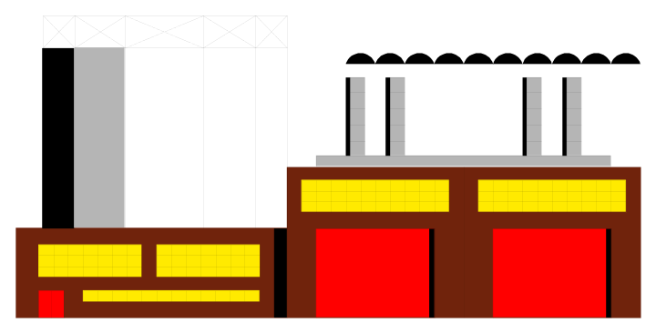
Stock Splits
A distribution of additional shares of stock to stockholders according to their percent ownership.
$10 par value
Old
Shares
Common Stock
100 shares
$5 par value
New
Shares
Common Stock
200 shares
ACCT 201 ACCT 201 ACCT 201

Slide 56
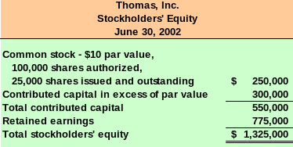
Stock Splits
Thomas, Inc. has the following stockholders’ equity section prior to a 2-for-1 stock split.
ACCT 201 ACCT 201 ACCT 201

Slide 57
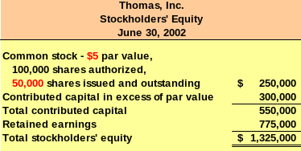
Stock Splits
After the 2-for-1 split the stockholders’ equity section of the balance sheet looks like this . . .
No accounting
entry is made.
ACCT 201 ACCT 201 ACCT 201

Slide 58
Stock Splits – A Real-World Example
11
Chapter

Slide 59
Stock Split | Shares | Cost Per Share | Market Price
1970 IPO | 100 | 16.50
May 1971 | 200 | 8.25 | $47.000
March 1972 | 400 | 4.125 | 47.500
Aug. 1975 | 800 | 2.06 | 23.000
Nov. 1980 | 1,600 | 1.03 | 50.000
June 1982 | 3,200 | 0.52 | 49.875
June 1983 | 6,400 | .0255 | 81.625
Sept. 1985 | 12,800 | 0.1275 | 49.750
June 1987 | 25,600 | 0.0625 | 66.625
June 1990 | 51,200 | 0.03125 | 62.500
Feb. 1993 | 102,400 | 0.015625` | 63.625
March 1999 | 204,800 | 0.0078125 | 89.750
204,800 shares @ $55.49 = $11,364,352.00

